Slide 1
NIEM 101
Technical Introduction to NIEM
Presenter Name
Organization
Date
TRAINING

Slide 2
Seminar Details
This course is designed to introduce National Information Exchange Model (NIEM) technical concepts. An overview of data model components as well as the development of NIEM-conformant information exchanges will be discussed.
If you are a technical resource new to NIEM, this is the course for you! All NIEM 300 level training courses build on the foundational concepts introduced in this course.
TARGET AUDIENCE: Technical resources such as architects, analysts, and developers.
DURATION
Approximately 1 Hour
PREREQUISITES
NIEM 100: NIEM General Overview

Slide 3
Learning Objectives
This course will provide you with a better understanding of NIEM’s technical architecture, exchange scope, and implementation.
By the end of this course, you will be able to:
Identify NIEM data components and how they work
Identify a NIEM Information Exchange Package Documentation (also known as an IEPD)
Understand the scope of NIEM and its relation to implementation
Understand NIEM-UML in the context of modeling exchanges and defining domains

Slide 4
agenda
NIEM Recap & Model Overview
NIEM Information Exchange Overview
NIEM Implementation
NIEM-UML
Conclusion

Slide 5
NIEM recap & model overview
Course Progress
0% complete

Slide 6
Niem overview
NIEM is a community-driven, government-wide, standards-based approach to exchanging information. Diverse communities can collectively leverage NIEM to increase efficiencies and improve decision-making.
It is available to everyone, including both public and private organizations. NIEM includes a data model, governance, training, tools, technical support services, and an active community to assist users in adopting a standards-based approach to exchanging data.
Community
Technical Framework
Support Framework
Formal Governance Processes
Data Model
Tools for Development and Discovery
Online Repositories
XML Design Rules
Established Training Program
Mission-Oriented Domains
Development Methodology
Implementation Support
Self-Managing Domain Stewards
Predefined Deliverables (IEPD)
Help Desk & Knowledge Center

Slide 7
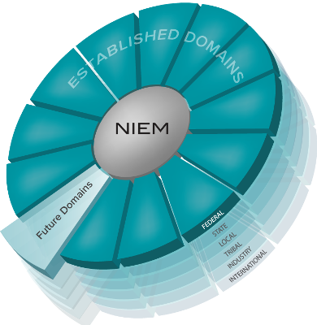
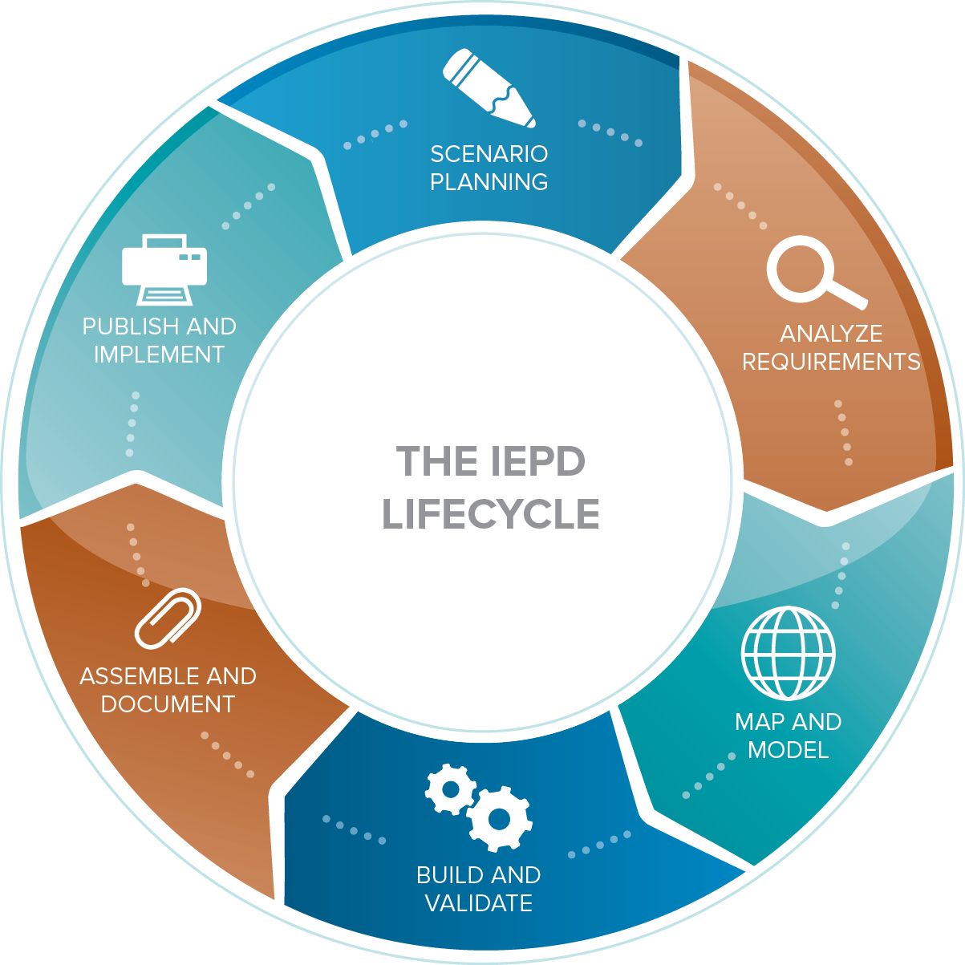
How niem works
Common Language (Community-driven Data Model)
Repeatable, Reusable Process
(Information Exchange Development Lifecycle)
Built and governed by the business users at Federal, State, Local, Tribal, International and Private Sectors

Slide 8
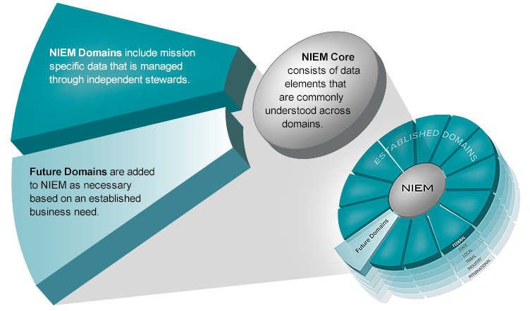
model overview
Words are to a dictionary as elements are to a data model.
Think of the NIEM data model as a mature and stable data dictionary of agreed-upon terms, definitions, and formats independent of how information is stored in individual agency systems.
The data model consists of two sets of closely related vocabularies: NIEM Core and individual NIEM Domains.

Slide 9
NIEM Core Components
Some important, practical NIEM Core components
<nc:Person>
<PersonBirthDate>
<PersonEyeColorText>
<PersonHairColorText>
<PersonSexText>
…
<nc:Activity>
<ActivityCategoryText>
<ActivityDate>
<ActivityDescriptionText>
<ActivityDisposition>
…
<nc:Item>
<ItemConditionText>
<ItemDescriptionText>
<ItemName>
<ItemValue>
…
<nc:Identification>
<IdentificationID>
<IdentificationJurisdiction>
<IdentificationEffectiveDate>
<IdentificationStatus>
…
<nc:Location>
<Address>
<LocationDescriptionText>
<LocationLandmarkText>
<LocationName>
…
<nc:Organization>
<OrganizationName>
<OrganizationDescriptionText>
<OrganizationCategoryText>
<OrganizationEstablishedDate>
…

Slide 10
NIEM Core Component: <nc:Person>
Approximately 200 discrete fields for Person information across all domains
<nc:PersonNameType>
<PersonNamePrefixText>
<PersonGivenName>
<PersonMiddleName>
<nc:PersonNameType>
…
<nc:Person>
<PersonName>
<PersonSex>
<PersonBirthDate>
<PersonHairColor>
<PersonPhysicalFeature>
<PersonCapability>
<PersonSSNIdentification>
<PersonInjury>
<PersonMedicalCondition>
…
<nc:PhysicalFeatureType>
<PhysicalFeatureCategory>
<PhysicalFeatureDescriptionText>
<PhysicalFeatureImage>
<PhysicalFeatureLocationText>
…
x
x
x
<nc:InjuryType>
<InjuryCategoryText>
<InjuryDate>
<InjuryDescriptionText>
<InjuryLocationText>
<InjurySeverityText>
…
x
<nc:MedicalConditionType>
<MedicalConditionText>
<MedicalConditionCauseText>
<MedicalConditionDescriptionText>
<MedicalConditionSeverityText>
…
x
x
x

Slide 11
NIEM Core Component: <nc:Activity>
<nc:Activity>
<ActivityDate>
<ActivityCategoryText>
<ActivityDescriptionText>
<ActivityDisposition>
…
<nc:Activity> has different derived types in NIEM
Derived types inherit all parent fields
Field meaning depends on context
x
<em:AlarmEvent>
<ActivityDate>
<ActivityCategoryText>
<ActivityDescriptionText>
<ActivityDisposition>
<AlarmEventCategoryCode>
<AlarmEventDetailsText>
…
x

Slide 12
Knowledge Check
True of False?
The NIEM model consists of two sets of closely related vocabularies: NIEM Core and individual NIEM Domains.
Some important practical NIEM Core components are <nc:Person>, <nc:Activity>, and <nc:Item>

Slide 13
NIEM Information Exchange overview
Course Progress
20% complete

Slide 14
What is a niem Information exchange?
In NIEM, an information exchange is also known as an Information Exchange Package Documentation (IEP), a description of specific information exchanged between a sender and a receiver. The IEP is usually coupled with additional documentation, sample XML instances, business rules,and more to compose an Information Exchange Package Documentation (IEPD)
Core Functions of an IEPD:
Developed to provide the business, functional, and technical details of the information exchange through predefined artifacts
Created with a core set of artifacts in a prescribed format and organizational structure to allow for consistency
Designed to be shared and reused in the development of new information exchanges through the publication in IEPD repositories

Slide 15
Scope of IEPDs
IEPDs DO
Include the XML schemas that define the XML message structure
Contain standardized artifacts that document an information exchange
Have a defined development methodology (IEPD Lifecycle)
Ease the documentation process for reuse
Allow for the capture of business rules that define an exchange
IEPDs DO NOT
Specify how exchange data is physically transferred between entities or systems
Describe an interface or Interface Control Document (ICD)
Specify any technical information outside of the message structure

Slide 16
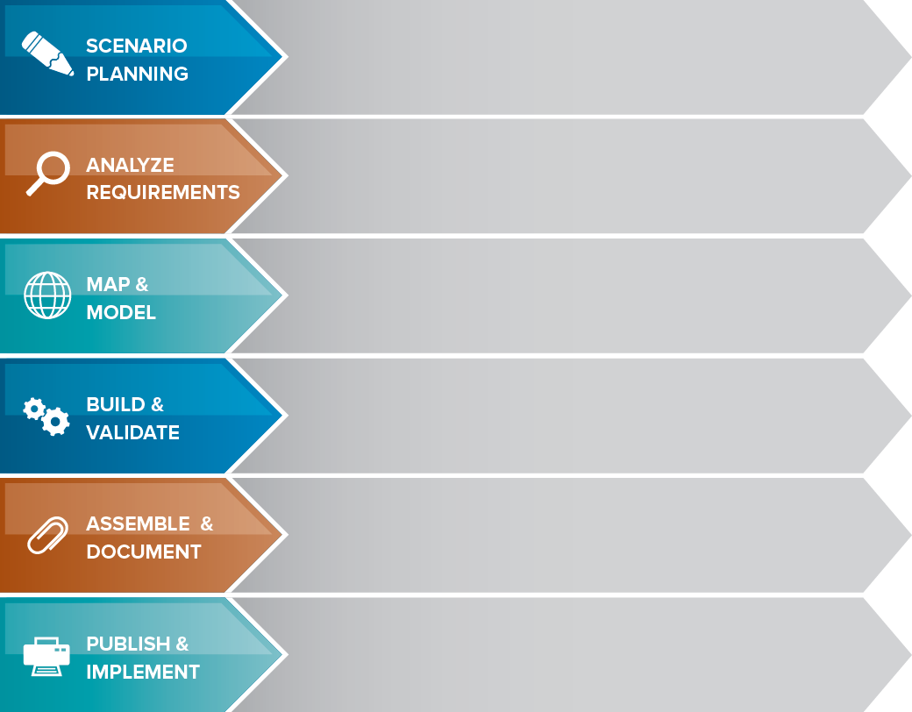
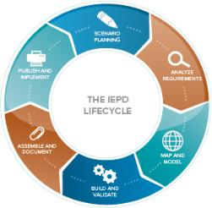
The iepd lifecycle
Review background, assess resource impact, understand business context, and identify information exchange business scenarios
Selected information exchange scenario is further elaborated to understand and document the business context and data requirements
Create an exchange content model based on information exchange requirements. The Exchange Content Model is then mapped to NIEM.
Create a set of exchange-specific NIEM conformant XML schemas that implement the exchange content model created for the exchange
Prepare and package all related files for the IEPD into a single self‐contained, self-documented, portable archive file
Publish the IEPD as well as implement the IEPD into production for search, discovery, and reuse

Slide 17
The iepd artifacts
Business Process Diagrams
Use Case Diagrams
Sequence Diagrams
IEPDs contain both required and recommended artifacts
Required:
Bold and Blue
Note:
Best practicesfor most organizations include many of the artifacts listed here.
Please review the Model Package Description (MPD) Specification for more information.
Business Rules
Business Requirements
Exchange Content Model
Mapping Document
Subset Schema
Exchange Schema
Wantlist
Constraint Schema
Extension Schema
Reference Schema
XML Stylesheets
Master Document
Catalog
Change Log
Sample XML Instances
No required artifacts. Publish the IEPD to a repository and implement the exchange

Slide 18
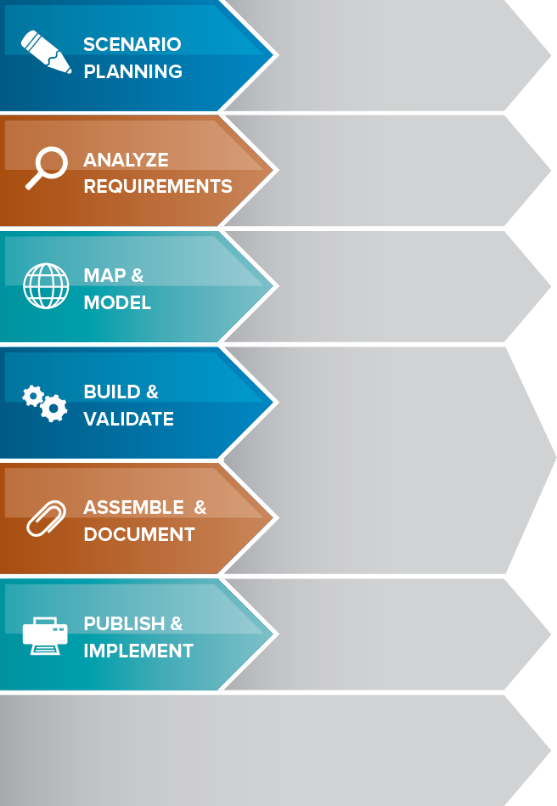
Systems Development Life Cycle
Plan
Develop high level scope and goals of intended system
The Systems Development Life Cycle (SDLC) is a common methodology used for creating information systems.
The IEPD Lifecycle aligns closely with the phases of the SDLC.
Requirements
Analyze goals and break them down into exact requirements
Design
Transform requirements into detailed system capabilities
Develop
Develop system per design specifications
Implement
Test and deploy system
Maintain
Sustain system per future plan and eventually move to disposition

Slide 19
Maintain an Exchange
After the project is complete, the IEPD needs to be maintained throughout its existence.
To sustain an IEPD:
 | Ensure that any changes to an information exchange are correctly reflected within the IEPD.
 | A governance process, if applicable, should be established to actively manage the changes identified for an IEPD
 | Once changes are made to the IEPD, publish a new version of the IEPD within online repositories
 | Over time, the technical architecture of the information exchange is likely to change; update the IEPD to reflect these changes
Choosing to not maintain an IEPD inhibits re-use within and outside the organization.
!

Slide 20

IEPD Reuse and Sharing
Existing IEPDs, after publication, can be reused partially or fully, which can:
Decrease IEPD development time
Reduce development cost
Increase Return on Investment (ROI)
Increase consistency of data definitions
IEPD REPOSITORIES, such as the IEPD Clearinghouse, can be leveraged to search and reuse existing IEPDs.
NIEM.gov/ojpiepdclearinghouse
ARTIFACTS and ELEMENTS within IEPDs can be leveraged to facilitate development and ease the burden on resources.

Slide 21
Example: Reuse of an Exchange
Commonwealth of Virginia
Developed an Exchange
State of New Jersey
Reused the Exchange
Child Welfare Information Exchange
Element 1
Element 2
Element 3
Element 4
Element 5
Child Welfare Information Exchange
Element 1
Element 3
Element 5
Re-use
x
x
x
x
x
x
Data Specific to Child Welfare in NJ
Element 6
Element 7
Element 8

Slide 22
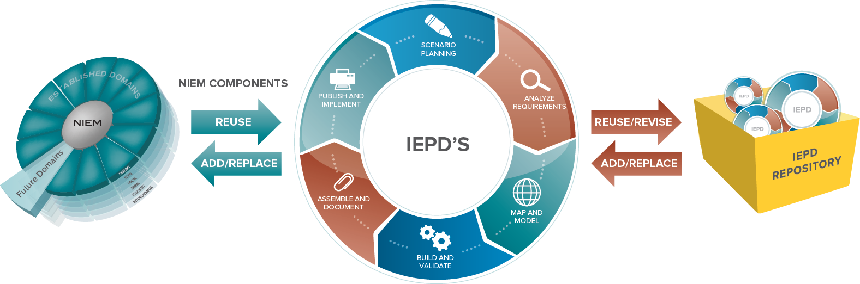
IEPDs AND NIEM ARCHITECTURE
NIEM continues to grow and evolve with practitioners’ contributions
New NIEM Domains
(plus associated components)

Slide 23
Knowledge Check
True of False?
IEPD stands for Information Exchange Package Database.
IEPDs contain standardized artifacts that document an information exchange.
While NIEM Development Life Cycle does not include a maintenance phase after Publish and Implement, Maintenance of an IEPD is important.

Slide 24
NIEM Implementation
Course Progress
40% complete

Slide 25
Implementing your NIEM Exchange
NIEM Does:
Define XML instance document format and structure.
NIEM Does Not:
Define implementation specifications.
Specify how a document is transmitted, but may employ encryption, Efficient XML Interchange (EXI), etc.

Slide 26
Example: Implementing NIEM
There are many ways to implement NIEM.
NIEM conformant exchanges are implemented based on business needs and vary as a result.
Two common examples include:
Message Queue: An organization can store NIEM conformant XML instances within a message queue during its response to a stakeholder’s information request service.
Web Services: An organization can embed a NIEM conformant schema into a new or existing Web Service and perform an electronic transfer with one or more exchange partners potentially through a Service Oriented Architecture (SOA) based environment.

Slide 27
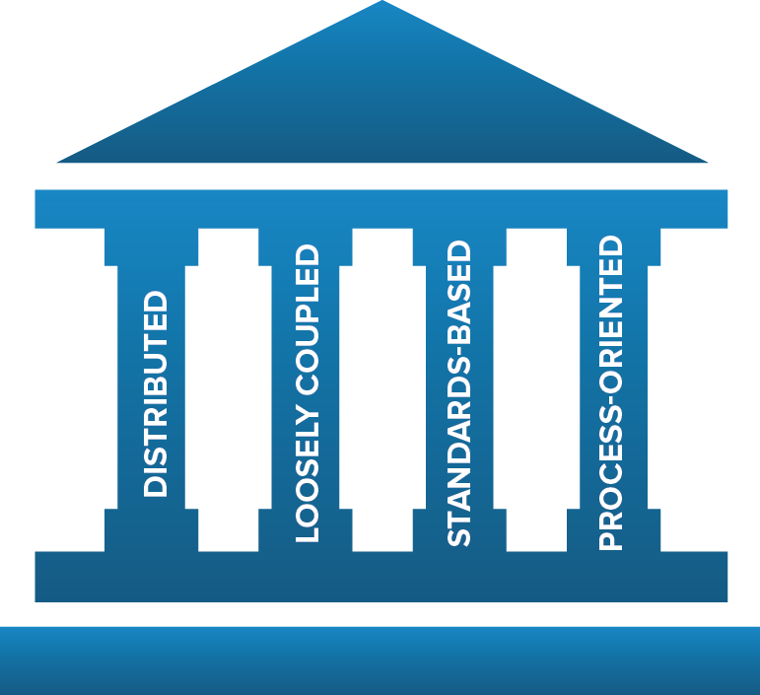
Example: SOA Implementation
Service Oriented Architecture (SOA) is an architectural style whose goal is to achieve loose coupling among interacting software agents.
Standards-Based:
NIEM provides the standard for data layer interoperability among services in SOA
NIEM can be used to standardize and structure the messages passed between services in SOA
NIEM can decrease development time of new services in SOA through reuse of similar IEPDs

Slide 28
Considerations for Implementation
Systems on either side of the exchange can use different implementation architectures (i.e. different programming languages, operating systems)
All participants in an information exchange must agree on the definition and structure for the data in the exchange—NIEM provides this standardization
IEPD Lifecycle should be used to guide development of NIEM conformant information exchanges to make sure all of the necessary artifacts are created
Elements already defined within NIEM should be used whenever possible; exchange elements outside of or created to fill requirements not covered in NIEM should also be reused whenever possible
ARCHITECTURE
CONSISTENCY
DEVELOPMENT
REUSE

Slide 29
Security and Privacy
Security and privacy should always be key considerations when implementing an exchange.
NIEM allows you to tag data with security and privacy, however, other technologies are required upon exchange implementation to enforce security and privacy rules.
NIEM allows the use of metadata to describe specific requirements in regard to information security and the handling of sensitive privacy-protected information.
Including this metadata allows systems that implement NIEM to automatically enforce rules that govern the use, protection, dissemination, and access controls for data being shared.
This has been put to use in the Intelligence community, which established the Intelligence Community Information Security Marking (IC-ISM) as a standard for classified information.
NIEM 3.0 provides support for existing versions of IC-ISM metadata attributes
NIEM does not dictate how agencies handle privacy issues. Consult with your organization’s privacy standards.

Slide 30
Knowledge Check
True of False?
NIEM does not define implementation specifications or specify how an exchange is transmitted.

Slide 31
NIEM-UML
Course Progress
60% complete

Slide 32
What is the NIEM-UML Profile?
NIEM-UML Profile: An extension of a subset of Unified Modeling Language (UML) that is specific to NIEM.
NIEM-UML generates 100% NIEM conformant information exchanges. This means that architects and developers who build NIEM exchanges don’t need to worry as much about the technology details, as outlined in the NIEM Naming and Design Rules (NDR), and the Model Package Description (MPD) Specification.
If you already use and understand UML, the typical learning curve that comes with NIEM development is greatly reduced.
UML provides a visual representation of an exchange that would be understandable to both technical and non-technical resources such as business stakeholders.
NIEM-UML’s use is dependent on tools that implement the profile.

Slide 33

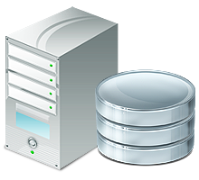
Using niem-uml to model information exchanges
Using the NIEM-UML profile with UML modeling tools, Developers can combine their own unique needs with the NIEM reference vocabularies to design information exchange models that will produce NIEM information exchange packages that power XML “on the wire” technologies.
XML data “on the wire”

Slide 34
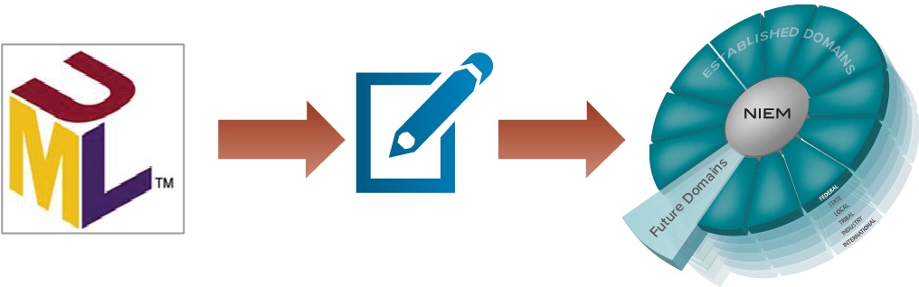
Using niem-uml to define new domains
NIEM-UML can also help users manage NIEM domain data model content. Domains created with NIEM-UML will have both a UML and XML schema representation.
Design & Model
Domain Vocabularies

Slide 35
Knowledge Check
True of False?
NIEM-UML generates NIEM conformant information exchanges.
NIEM-UML can be used for both exchange development and for domain data model management.

Slide 36
CONCLUSION
Course Progress
80% complete

Slide 37
Learning recap
This course should now provide you with a better understanding of NIEM’s technical architecture, exchange scope, and implementation.
You should now be able to:
Identify NIEM data components and how they work
Identify a NIEM Information Exchange Package Documentation (also known as an IEPD)
Understand the scope of NIEM and its relation to implementation
Understand NIEM-UML in the context of modeling exchanges and defining domains

Slide 38
Additional NIEM Resources
For technical documentation:
NIEM.gov/reference
For all things NIEM:
NIEM.gov
DOCUMENTATION AND STANDARDS
For available resources that provide support and assistance:
NIEM Training: NIEM.gov/training NIEM Webinars: NIEM.gov/webinars NIEM Helpdesk: NIEM.gov/contactus
TRAINING & TECHNICAL ASSISTANCE
Available Tools for developers:
Visit the NIEM Tools Catalog today! NIEM.gov/tools
TOOLS

Slide 39
Next steps
Start your action plan and schedule your resources for NIEM training!
 | NIEM 100 | NIEM 101 | NIEM 200 | NIEM 300 | NIEM 301 | NIEM 302 | NIEM 303
Executive Managers
Program and Project Managers
Architects
Developers
= Required
= Optional depending on role

Slide 40
End of course
Course Progress
100% complete

